Slide 1
TYPING SPEED EVALUATION SYSTEM
A Comprehensive Java Swing Application for Typing Skills Development
PRESENTED BY:
AINA AZHAR{003}
ALI HAMZA {004}
PRESENTED TO:
SIR YASIR MUNIR

Slide 2

Introduction
It is a Java Swing–based application designed to help users practice and improve their typing skills.
It supports both Free and Premium user roles, offers real-time performance tracking, maintains a detailed history and leaderboard to encourage competition and continuous improvement.

Slide 3
Overview

Slide 4

JAVA SWING GUI APPLICATION
Graphical user interface
Real-time visual feedback
Professional layouts and styling

Slide 5
DUAL USER ROLES
Free Users: Basic features
Premium Users: Enhanced features
Role-specific interface

Slide 6
TYPING ECOSYSTEM
Multiple difficulty levels to match each user’s skill progression
Detailed performance analytics for speed, accuracy, and time tracking
Global leaderboard to promote competitive typing practices
Reliable data persistence for storing user records, history, and scores

Slide 7
PROGRAM FLOW

Slide 8
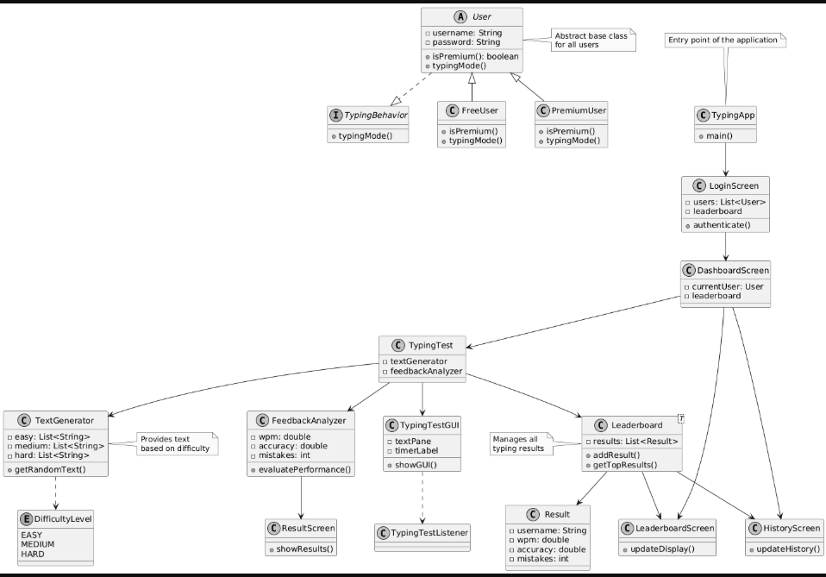

Slide 9
Key Features

Slide 10

USER MANAGEMENT
AUTHENTICATION SYSTEM
User registration with type selection
Login validation
Password checking
Session management

Slide 11
USER TYPES
FreeUser Class: Limited access
PremiumUser Class: Full access
Abstract User base class
Serializable implementation

Slide 12
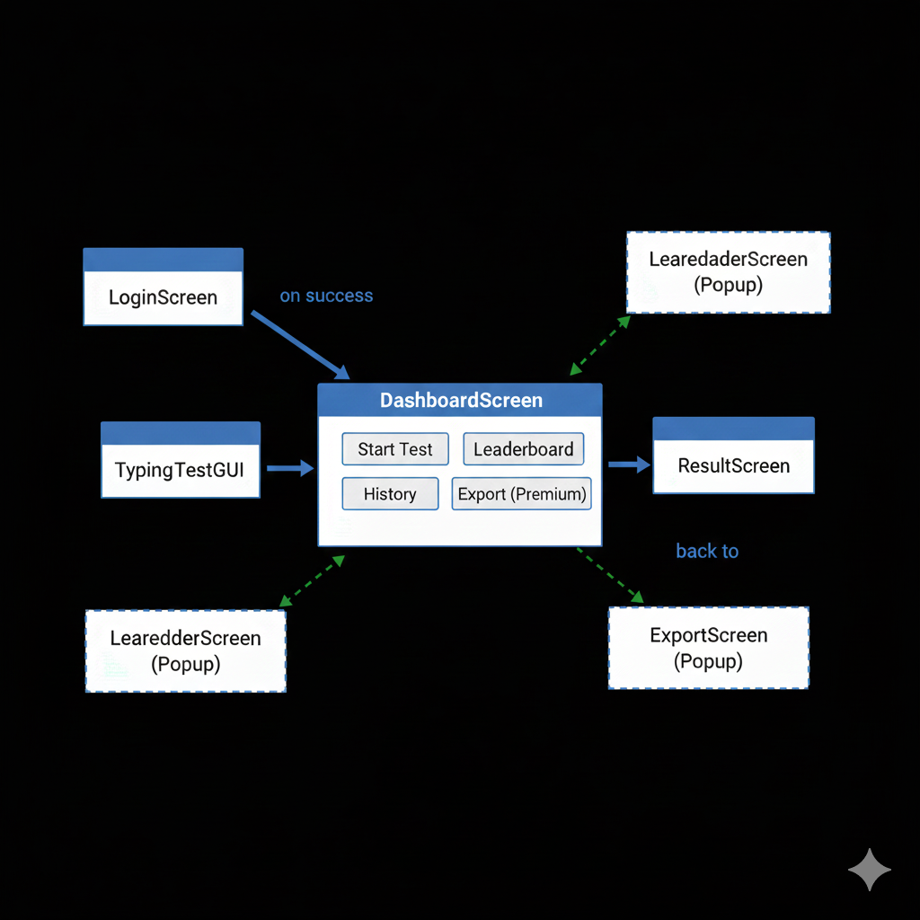
DASHBOARD SCREEN
CENTERAL NAVIGATION HUB
Personalized welcome message
Role-based button display
Premium feature indication
FEATURES AVAILABLE
Start Typing Test (All users)
View My History (All users)
Export My History (Premium only)

Slide 13
TEXT GENERATION SYSTEM
DIFFICULTY LEVELS
Easy: Simple sentences
Medium: Paragraphs
Hard: Complex passages
TEXT FILES
easy.txt: Basic typing practice
medium.txt: Intermediate practice
hard.txt: Advanced practice

Slide 14

FEEDBACK ANALYZER
PERFORMANCE METRICS
WPM Calculation
Accuracy Percentage
Mistakes Counting
Time-based analysis
CALCULATION FORMULAS
WPM = (characters / 5) / minutes
Accuracy = (correct characters / total) × 100
Mistakes = char mismatch + extra/missing

Slide 15
RESULT SCREEN
TEST COMPLETION DISPLAY
Final WPM score
Final accuracy percentage
Total mistakes count
Save confirmation

Slide 16
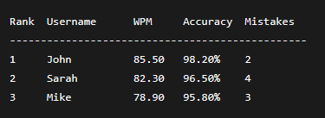
HISTORY SCREEN
PERSONAL STATISTICS
User-specific history
All past test results
Sortable by WPM/Date
FEATURES
Clean tabular display
Scrollable interface

Slide 17
PREMIUM FEATURES
DIFFICULTY SELECTION
Easy, Medium, Hard levels
Interactive dialog choice
Default fallback handling
EXPORT FUNCTIONALITY
Save history as text file
Native file chooser
Formatted output

Slide 18
Code Structure

Slide 19
CORE CLASSES (25+ FILES)
User Management: 4 classes
Typing Engine: 4 classes
GUI Components: 6 classes
Leaderboard System: 4 classes
Data Models: 1 class
Main Controller: 1 class

Slide 20

FILE ORGANIZATION
TEXT FILES (INPUT)
easy.txt - Beginner sentences
medium.txt - Intermediate text
hard.txt - Advanced passages
BINARY FILES (STORAGE)
users.dat - User objects
results.dat - Result objects

Slide 21
SWING COMPONENTS USED
GUI ELEMENTS
JFrame - Main windows
JPanel - Container panels
JButton - Action buttons
JLabel - Text displays
JTextField - Input fields
JTextPane - Styled text
JScrollPane - Scroll areas

Slide 22

EVENT HANDLING
ACTION LISTENERS
Button click events
Menu selection
Dialog responses
KEY LISTENERS
Typing detection
Backspace handling
Enter key submission

Slide 23
Strengths

Slide 24
MODULAR DESIGN
Clear separation of concerns
Easy maintenance
Reusable components
Scalable architecture

Slide 25

FILE-BASED PERSISTENCE
No database dependency
Simple implementation
Cross-platform
Easy backup

Slide 26

COMPILATION & EXECUTION
COMPILATION COMMAND
javac TypingApp.java
EXECUTION COMMAND
java TypingApp
FILE REQUIREMENTS
All .java files in same directory
Text files (easy.txt, medium.txt, hard.txt)
Binary files auto-generated

Slide 27
TESTING

Slide 28

SCENARIOS
SCENARIO 1: USER REGISTRATION
Register as Free User
Register as Premium User
Verify role differences
SCENARIO 2: TYPING TEST
Complete typing test
View real-time stats
Check final results

Slide 29
SCENARIO 3: LEADERBOARD
View global rankings
Check personal history
Verify data persistence
SCENARIO 4: PREMIUM FEATURES
Difficulty selection
History export
Feature comparison

Slide 30

CONCLUSIONS
ACHIEVEMENTS
Complete functional application
Professional GUI implementation
Robust data persistence
Role-based feature system
TECHNICAL SKILLS DEMONSTRATED
Java Swing development
File I/O operations
Object-oriented design
Event-driven programming

Slide 31
THANK YOU

